Slide 1

Distracted Driving Detection
Mouni Preetham Malyala EE18B019
B Midhun Varman EE18B113
Akhila Datta Dola EE18B131

Slide 2
What is Distracted Driving?
Distracted driving is any activity that diverts attention from driving such as talking or texting on your phone, eating or anything that takes your attention away from the road.
Driving requires complete attention and any distraction such as texting, which is one of the most dangerous distractions, sending or reading a text takes your eyes off the road for 5 seconds. That’s equivalent to travelling eyes closed for an entire football field at 70 kmph is dangerous.

Slide 3
Consequences
U.S. Department of Transportation, National Highway Traffic Safety Administration estimates that close to 14% of all car accidents are caused due to distracted drivers making it the leading cause of road accidents.
This has only been worsened due to proliferation of new distraction triggers such as smartphones.
It has become common to notice drivers who are texting or scrolling down an app feed. Sadly, this translates to 425,000 people injured and 3,000 people killed by distracted driving every year.
Texting while driving is 6x more likely to cause an accident than driving drunk, causing a 400 percent increase in time spent with eyes off the road.
94 percent of drivers support a ban on texting while driving.
74 percent of drivers support a ban on hand-held cell phone use.

Slide 4
GOALS
To implement different classification techniques to detect if a driver is paying attention to the road or is involved in some distraction activities and to classify the distraction activities. (texting, talking, reaching around, etc.)
Implementing the below 3 classification models and calculating the accuracy for these models: -
Linear SVM
Naive Bayes
Convolutional Neural Networks
Benchmarking the accuracies of these different models and identifying which best suits the given problem. Calculating per class accuracy of the best possible model.

Slide 5
Data Set Description
The input was collected from the StateFarm dataset (available on Kaggle) which contains snapshots from a video captured by a camera mounted in the car.
The whole training dataset contains 22,424 labeled images and 79,700 unlabeled test images. The size of each image is 640×480 pixels.

Slide 6
Classification classes
c0: safe driving
c1: texting - right
c2: talking on the phone - right
c3: texting - left
c4: talking on the phone - left
c5: operating the radio
c6: drinking
c7: reaching behind
c8: hair and makeup
c9: talking to passenger

Slide 7
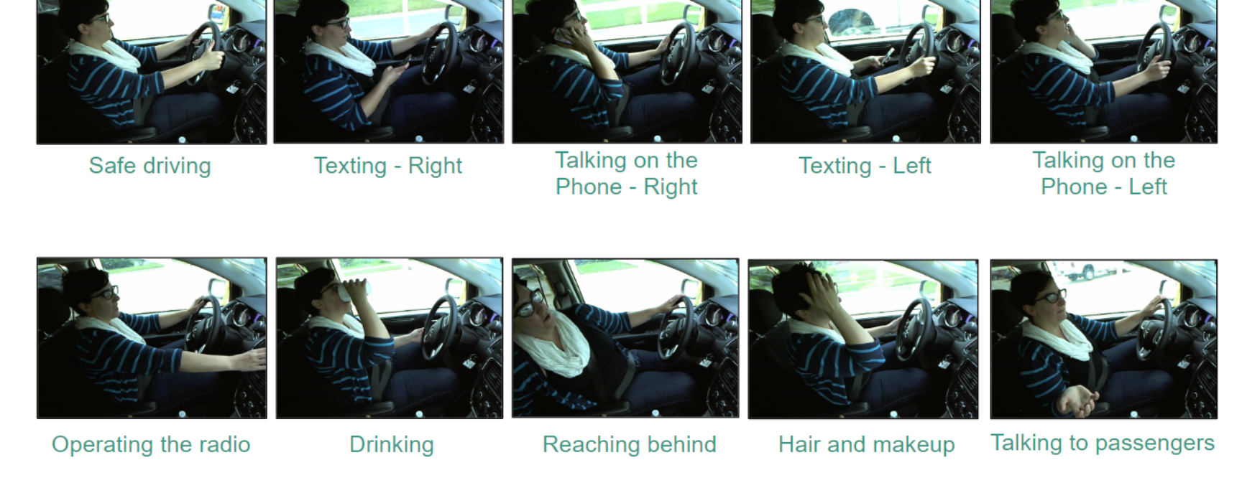
Sample images from the dataset

Slide 8
Existing Research
Before Deep Learning was prominent
With Deep Learning emerging
Existing Research in Chronological order

Slide 9
Before Deep Learning was prominent
Before the emergence of deep learning, approaches based on support vector machines (SVMs) and decision trees have dominated the research in distracted driver detection. With Deep Learning emerging

Slide 10
With Deep Learning emerging
Lately, with the great success of deep learning models, particularly the convolutional neural networks (CNNs) in computer vision, CNNs emerged to be the state-of-art-technique for computer vision problems.CNNs have become the dominant approach to solve the distracted driving problem as well. Three main topics that researchers focus on are image preprocessing techniques, classifying model selection and types of distractions (classes).

Slide 11
Existing Research in Chronological order:
Initial work was done on distraction due to mobile phone by Zhang et al in 2011, achieved 94.2 % using R-CNN model.
University of California San Diego’s Laboratory of Intelligent and Safe Automobiles created a model which used a fusion of classifiers where the image is to be segmented into three regions: wheel, gear, and radio and detect the existence of hands in those regions

Slide 12
StateFarm’s Distracted Driver Detection competition on Kaggle(edit this)
t in April-2016 the first publicly available dataset was released by StateFarm’s Distracted Driver Detection competition on Kaggle, research in the field expanded there after.
In 2017, Abouelnaga et al. proposed a solution using a weighted ensemble of five different Convolutional Neural Networks. The system achieved good classification accuracy of 95.98%, but it’s too complex for real-time detection.
Baheti et al. addressed this problem of time complexity and reduced the number of parameters significantly and achieved an accuracy of 95.54% - this was considered the best in terms of accuracy and computational time, except for some research works which used edge and cloud platforms apart from camera based identification to detect driver distractions .

Slide 13
Our Plans
We plan to implement the below 3 classification models:
Linear SVM
Naive Bayes
Convolutional neural networks
And benchmark results for each

Slide 14
Our Plans
We plan to implement the below 3 classification models:
Linear SVM
Naive Bayes
Convolutional neural networks
Image PreProcessing
Image Augmentation
Avoiding Data Leakage
Hyperparameter tuning in CNNs
Using pre-trained models
Using LeakyReLU Activation Function
Ensembling different models
Try out semi-supervised learning
Computational time
And benchmark results for each using Logarithmic loss

Slide 15
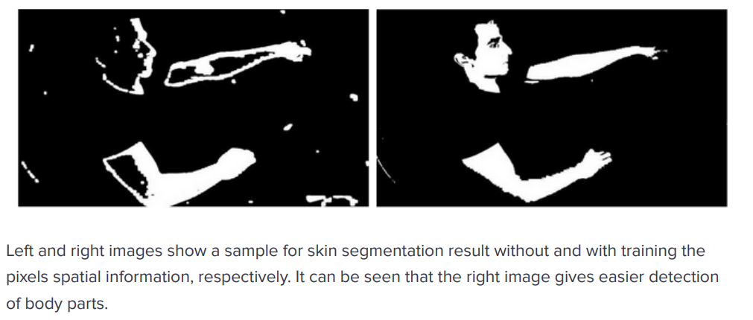
Image PreProcessing
The given 640x480 pixel images are converted to high dimensional matrix
Pixel wise skin segmentation is applied for better distinction of certain parts like head

Slide 16
Image Augmentation
Image Augmentation is a technique that creates more images from the original by performing actions such as shifting width and/or height, rotation, and zoom.

Slide 17
Avoiding Data Leakage
Our training data has multiple images of the same person within a class with slight changes of angle and/or shifts in height or width.
This causes data leakage
Solving by spliting the images based on the person IDs in the same ratio(80:20 split).

Slide 18
Hyperparameter tuning in CNNs and Using pre-trained models
Tweaking hyper parameters on pretrained model
Pre-trained models that were developed for standard computer vision benchmark datasets, such as the ImageNet image recognition challenge.
Some of the pre-trained models include: VGG-16, RESNET50, Xception and Mobilenet models.

Slide 19
Using LeakyReLU Activation Function

Slide 20
Ensembling different models
Ensemble different models into a single model
By tuning the weights appropriately
Or using a genetic algorithm to find the best weights possible.

Slide 21
Try out semi-supervised learning
As more data generally makes a model more accurate.
Semi-supervised learning to convert those test images which are predicted with high confidence(probability) into labelled training data and check if this gives a better model

Slide 22
Computational time
Trade-off between the computational time for detection and accuracy of the model.

Slide 23
Logarithmic loss
it’s important to choose the right metric to gauge its performance
Logarithmic loss (related to cross-entropy) measures the performance of a classification model where the prediction input is a probability value between 0 and 1

Slide 24
Thank You

